Slide 1
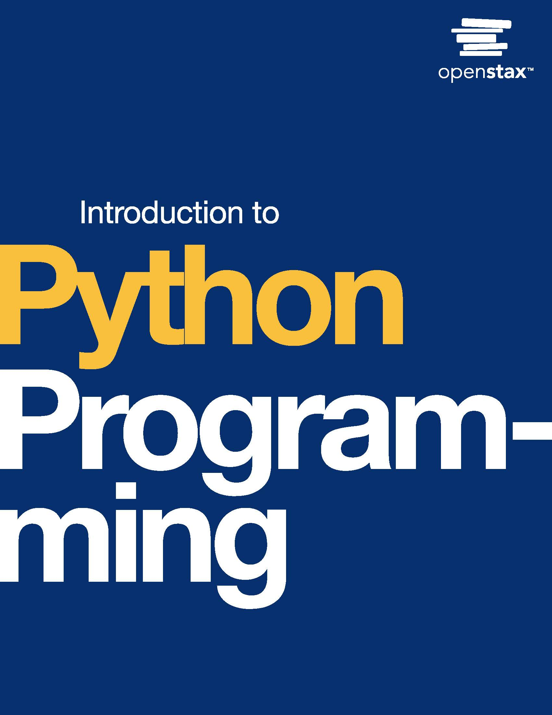
Introduction to Python Programming
Chapter 12: Recursion

Slide 2
Chapter outline
Recursion basics
Simple math recursion
Recursion with strings and lists
More math recursion
Using recursion to solve problems

Slide 3
12.1 Recursion basics
Learning Objectives
Describe the concept of recursion.
Demonstrate how recursion uses simple solutions to build a better solution.

Slide 4
12.1 Recursion basics
Recursion
Recursion is a problem solving technique that uses the solution to a simpler version of the problem to solve the bigger problem.
In turn, the same technique can be applied to the simpler version.
The recursion process continues until the problem is small enough, at which point the solution is known or can easily be found.
The larger solution can then be built systematically by successively building ever larger solutions until the complete problem is solved.

Slide 5
12.2 Simple math recursion
Learning Objectives
Identify a recursive case and a base case in a recursive algorithm.
Demonstrate how to compute a recursive solution for the factorial function.

Slide 6
12.2 Simple math recursion
Calculating a factorial
The factorial of a positive integer is defined as the product of the integer and the positive integers less than the integer.
Ex: 5! = 5 * 4 * 3 * 2 * 1
Written as a general equation for a positive integer n: n! = n * (n - 1) * (n - 2) * . . . * 1
The above formula for the factorial of n results in a recursive formula: n! = n * (n - 1)!
Thus, the factorial of n depends upon the value of the factorial at n - 1. The factorial of n can be found by repeating the factorial of n - 1 until (n - 1)! = 1! (we know that 1! = 1).
This result can be used to build the overall solution as seen in the animation below.

Slide 7
12.2 Simple math recursion
Defining a recursive function
Recursive algorithms are written in Python as functions. In a recursive function different actions are performed according to the input parameter value. A critical part of a recursive function is that the function must call itself.
A value for which the recursion applies is called the recursive case. In the recursive case, the function calls itself with a smaller portion of the input parameter. Ex: In the recursive function factorial(), the initial parameter is an integer n. In the function's recursive case, the argument passed to factorial() is n - 1, which is smaller than n.
A value of n for which the solution is known is called the base case. The base case stops the recursion. A recursive algorithm must include a base case; otherwise, the algorithm may result in an infinite computation.
To calculate a factorial, a recursive function, factorial() is defined with an integer input parameter, n. When n > 1, the recursive case applies. The factorial() calls itself with a smaller argument, n - 1. When n == 1, the solution is known because 1! is 1; therefore, n == 1 is a base case.
Note: 0! is defined to be 1; therefore, n == 0 is a second base case for factorial(). When n < 1, an error is returned.

Slide 8
12.3 Recursion with strings and lists
Learning Objectives
Demonstrate the use of recursion to solve a string problem.
Demonstrate the use of recursion to solve a list problem.
Use the built-in count() list function.

Slide 9
12.4 More math recursion
Learning Objectives
Define a recursive function to generate Fibonacci numbers.

Slide 10
12.4 More math recursion
Fibonacci sequence using recursion
The Fibonacci sequence is a sequence in which each number in the sequence is the sum of the previous two numbers in the sequence.
The first two numbers are 0 and 1.
Thus, starting from 0 and 1, the third number is 0 + 1 = 1, and the next number is 1 + 1 = 2. The sequence of numbers is 0, 1, 1, 2, 3, 5, 8, 13, 21, 34, ... .
Recursion can be used to calculate the nth Fibonacci number.
The base cases are 0 and 1.
Thereafter, the nth number is given by adding the (n - 1)th and (n - 2)th number. Thus, fib(n) = fib(n - 1) + fib(n - 2), which is a recursive definition ending with base cases f(0) = 0, and f(1) = 1.
For a recursion that calls multiple functions in the recursive case, tracing how the recursion proceeds is useful.
A structure used to trace the calls made by a recursive function is called a recursion tree. The animation below traces the recursion tree for a call to a recursive function to calculate the Fibonacci number for n = 5.

Slide 11
12.4 More math recursion
Greatest common divisor (GCD)
The greatest common divisor (GCD) of two positive integers is an integer that is a divisor for both integers. Ex: The GCD of 6 and 9 is 3 because 3 x 2 = 6, and 3 x 3 = 9.
The GCD is found easily using Euclid's method. Euclid's method recursively subtracts the smaller integer from the larger integer until a base case with equal integers is reached. The greatest common divisor is the integer value when the base case is reached.

Slide 12
12.5 Using recursion to solve problems
Learning Objectives
Use recursion to efficiently search a list.
Demonstrate a solution to the Three Towers problem.

Slide 13
12.5 Using recursion to solve problems
Binary search
Searching a sorted list usually involves looking at each item. If the item being searched is not found, then the search can take a long time.
A binary search is a recursive algorithm used to efficiently search sorted lists. In each recursive step, about half the items are discarded as not being potential matches, so the search proceeds much faster.
A binary search begins by checking the middle element of the list. If the search key is found, the algorithm returns the matching location (base case).
Otherwise, the search is repeated on approximately half the list.
If the key is greater than the middle element, then the key must be on the right half, and vice versa.
The process continues by checking the middle element of the remaining half of the list.

Slide 14
This ancillary resource is licensed under a Creative Commons Attribution-NonCommercial-ShareAlike 4.0 (CC BY NC-SA) license; it may be distributed, remixed, built upon for noncommercial purposes only, and must be attributed to OpenStax and redistributed under the same license.

